Slide 1
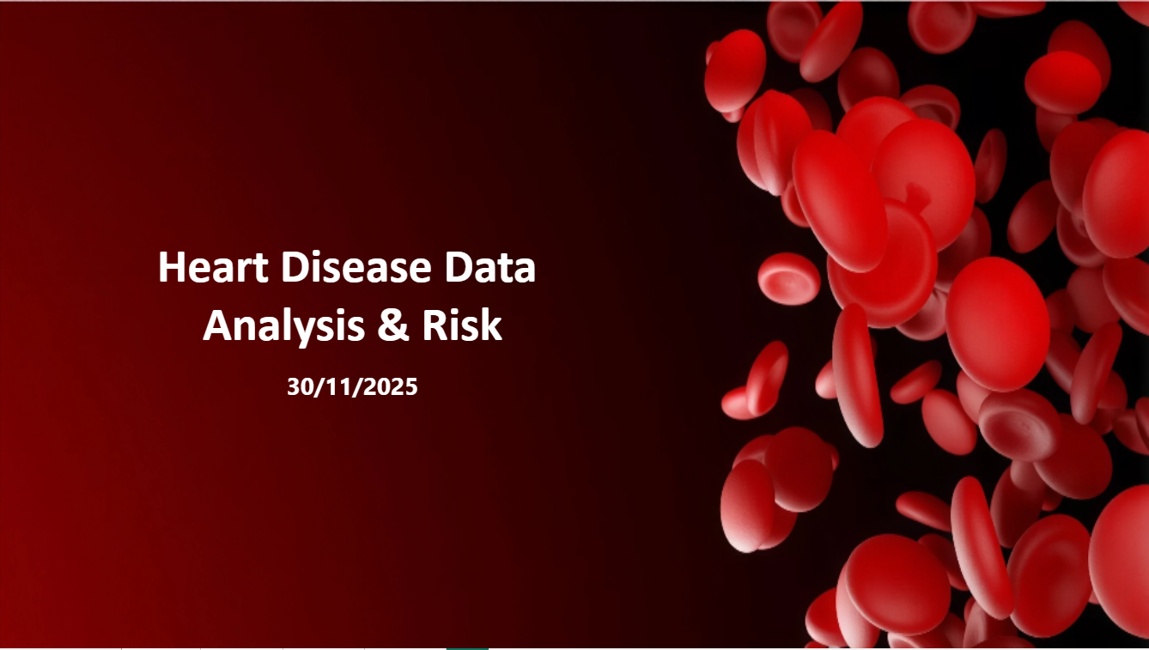


Slide 2


Problem Overview & Proposed Solution
Brief description of the problem being solved
Overview of the proposed solution (high-level idea):
Cardiovascular disease risk remains high despite awareness of healthy living. There are inconsistencies in heart health outcomes among people with similar demographics, lifestyle, and clinical profiles.
Analyze patient health records to identify key factors influencing cardiovascular disease, including lifestyle habits, clinical indicators, and demographics. Create new variables like BMI and Blood Pressure Classification to improve analysis and insights.
Unique value proposition (what makes the project stand out):
The project combines demographic, lifestyle, and clinical data to uncover correlations and provide data-driven insights for early intervention and preventive strategies, helping improve cardiovascular health proactively.

Slide 3
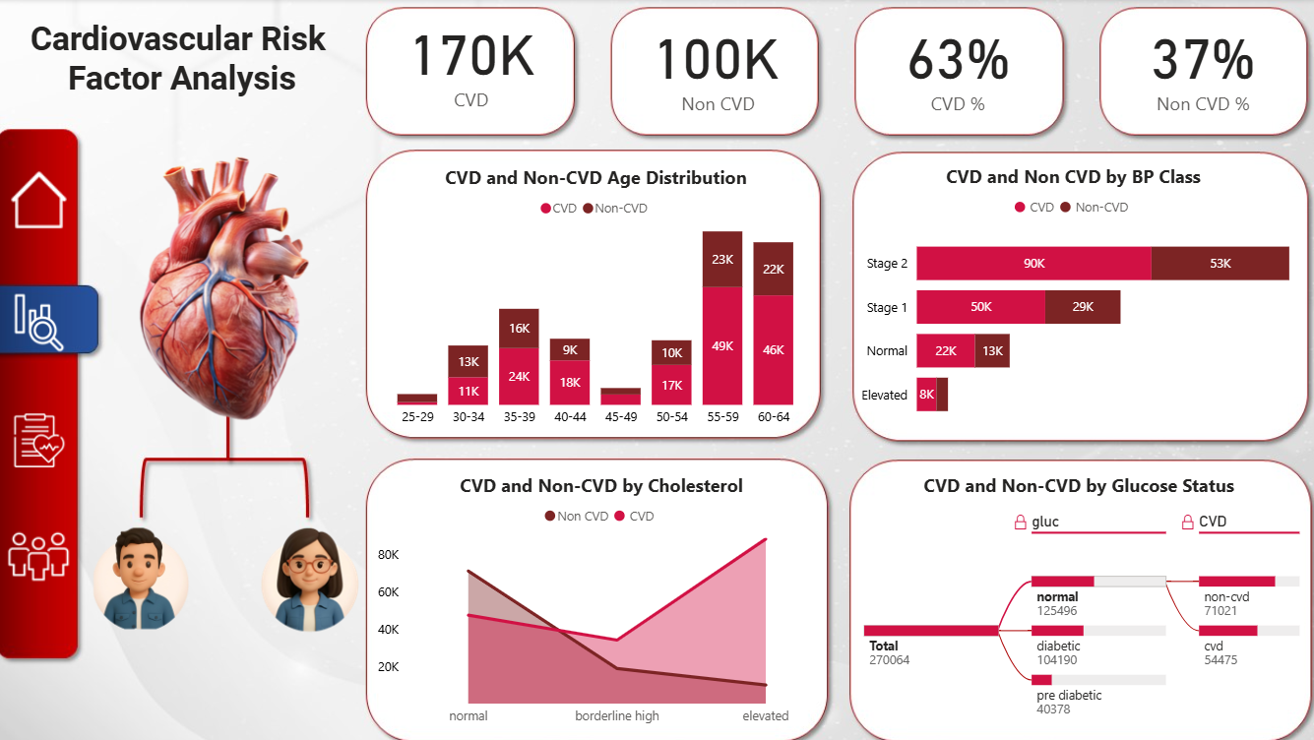

Slide 4
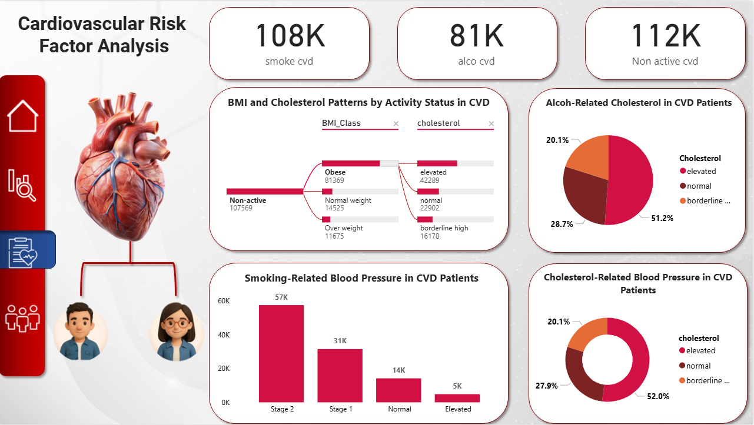

Slide 5
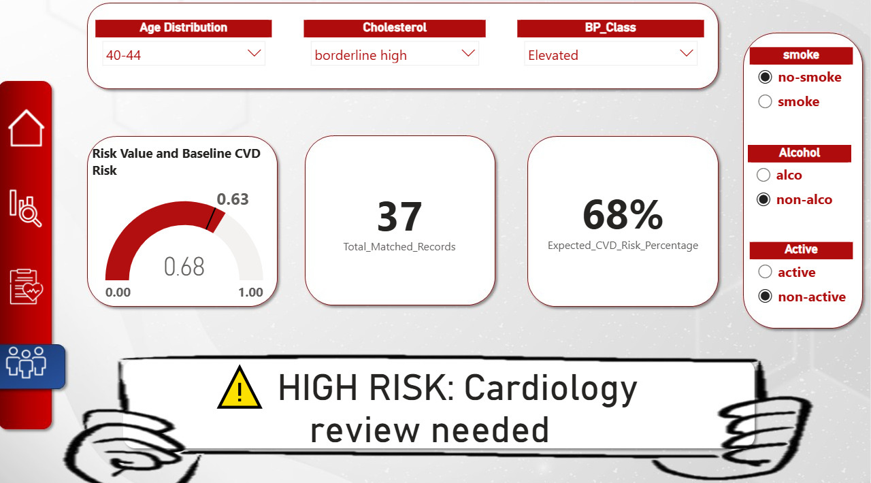

Slide 6

Dataset Description for
Heart Disease Analysis

Slide 7
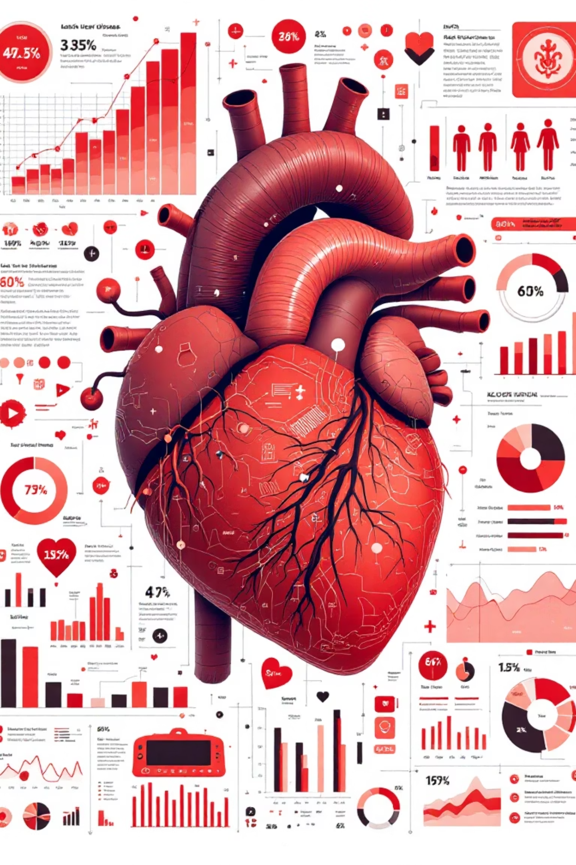
Dataset Description
id: Unique patient identifier
age: Age in years
gender: Male or Female
age distribution: Grouped age ranges
height: Height in cm
weight: Weight in kg
BMI: Body Mass Index
BMI_Class: BMI category
ap_hi: Systolic blood pressure
ap_lo: Diastolic blood pressure
glucose: Glucose level (normal , pre diabetic , diabetic ).
cholesterol: Cholesterol level (Normal ,Elevated, Borderline High ).
smoke: Smoker or Non-smoker
active: Active or Non-active
Alcohol: Alcohol , non-Alcohol
BP_Class: Blood pressure category
CVD: Has disease or Not
Blood pressure:(Normal, Type1, Type2)

Slide 8
Data Cleaning for Heart
Disease Analysis

Slide 9
Data Cleaning
Importing Libraries
Loading the Dataset
Initial Data Overview
We begin by importing the Pandas library, a fundamental tool for data manipulation and analysis in Python. It provides powerful data structures like DataFrames, essential for handling tabular data.
Next, the raw dataset is loaded from an Excel file into a Pandas DataFrame. This step transforms the data into an accessible format, ready for immediate viewing and preprocessing.
To get a quick glimpse of our data's structure, we display the first few rows. This reveals column names, data types, and sample values, guiding our initial cleaning strategy.
Removed unnecessary
columns
Replaced Values
Converted age from days to years
We removed columns that were not relevant to our analysis in order to simplify the dataset, reduce noise, and keep only the features that contribute to meaningful insights.
We replaced numeric codes with descriptive labels (e.g., gender, cholesterol, glucose, activity) to make the dataset more readable and interpretable, improving clarity for analysis and visualization.
We converted the age values from days to years to make the data more understandable and meaningful for analysis and interpretation.

Slide 10
Data Cleaning
Checked for missing
and duplicates
Removed outliers
Calculated BMI and rounded values
We examined the dataset for missing values and duplicate records to ensure data quality, maintain accuracy, and prepare it for reliable analysis.
We identified and removed outliers in age, weight, BMI, and blood pressure to ensure the dataset reflects realistic values, improving the accuracy and reliability of our analysis.
We calculated the Body Mass Index (BMI) for each individual and rounded the values to simplify the data, making it easier to interpret and analyze.
Created BMI classification
Classified blood pressure
Grouped age into age distribution ranges
We categorized BMI values into classifications (Underweight, Normal, Overweight, Obese) to better interpret health risk levels and facilitate meaningful analysis.
We classified blood pressure values into BP_Class categories (Normal, Elevated, Hypertension Stage 1, Hypertension Stage 2) to assess cardiovascular risk and make the dataset more interpretable.
We grouped age values into defined ranges to create an age distribution, making it easier to analyze patterns and trends across different age groups.

Slide 11
Data Cleaning
Verified and previewed
cleaned dataset
Reordered columns for
better organization
Exported cleaned dataset for analysis
We verified the cleaning steps and previewed the final dataset to ensure data accuracy, consistency, and readiness for analysis and visualization.
We rearranged the columns to create a more logical structure, improving readability and making the dataset easier to navigate during analysis.
We exported the cleaned and organized dataset to a new file, ensuring it is ready for further analysis, visualization, or modeling.

Slide 12
Data Pre-Processing for
Heart Disease Analysis

Slide 13
Data Pre-Processing
Further analysis of our comprehensive dataset provides granular detail on patient demographics and health metrics, reinforcing the foundation for our CVD risk model.
Dataset Scope Confirmed
Our dataset encompasses 270,000 patient records, each with 18 column, offering a broad spectrum of health data for robust modeling.
Key Patient Statistics
Age: Average 53 years (range: 25–84)
Height: Average 168 cm (range: 145–194 cm)
Blood Pressure Readings
Weight: Average 96 kg (range: 45–199 kg)
Systolic BP (ap_hi): Average 135 mmHg (range: 90–179 mmHg)
BMI: Average 34.7 (range: 13.3–88.4)
Diastolic BP (ap_lo): Average 84.5 mmHg (range: 60–109 mmHg)

Slide 14
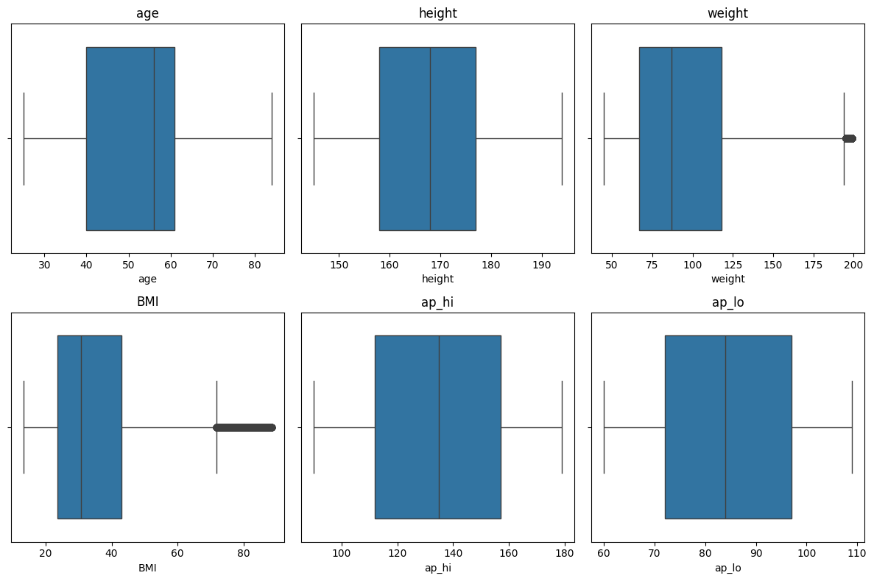
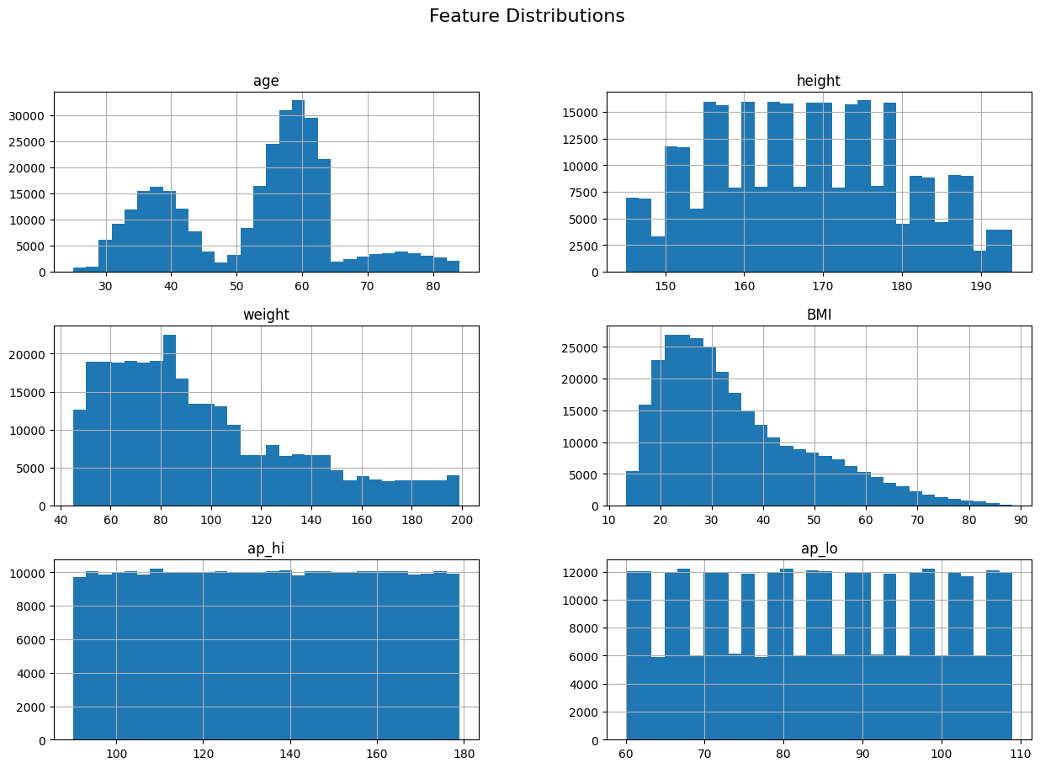
Data Pre-Processing
Targeting Outliers for Accuracy
Unveiling Feature Distributions
Visualizations like histograms and boxplots, combined with the Interquartile Range (IQR) method, were critical in detecting and removing 3,379 weight and 5,605 BMI outliers, enhancing data
quality for precise modeling.
Histograms provided essential visual insights into the spread and
central tendencies of our key health-related features. This allowed us
to identify skewness, gaps, and potential issues, informing subsequent modeling decisions.

Slide 15
Data Calculation & Visualization for
Heart Disease Analysis

Slide 16
Data Calculation
CVD Prevalence
Risk Factor Analysis
Risk Prediction & Guidance
Total CVD: Number of individuals diagnosed with CVD.
Smokers CVD: Number of smokers diagnosed with CVD.
Total Matched Records: Number of records after applying specific filters.
Total Non-CVD: Number of individuals without CVD.
Alcohol CVD: Number of alcohol users diagnosed with CVD.
Expected CVD Risk Percentage: Predicted CVD risk based on filtered data.
CVD %: Percentage of the population with CVD.
Non-active CVD: Number of non-active individuals diagnosed with CVD.
Risk Guidance Message: A textual message indicating the risk category.
Non-CVD %: Percentage of the population without CVD.
Gauge Risk Value: Clean numerical value for gauge visualizations.
Baseline CVD Risk: Overall CVD risk in the unfiltered population.

Slide 17
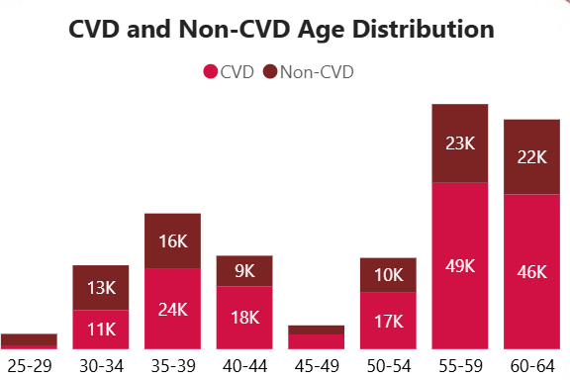
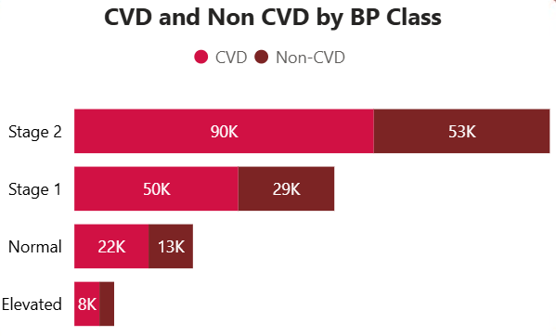
Data Visualization
The chart highlights the distribution of CVD and non-CVD cases across blood pressure classes
The chart shows the age distribution of CVD and non-CVD cases
Showing a clear increase in both groups after age 55, indicating higher risk as age progresses
showing a clear rise in cases at higher blood pressure stages, while the counts remain lower in the Normal and Elevated categories

Slide 18
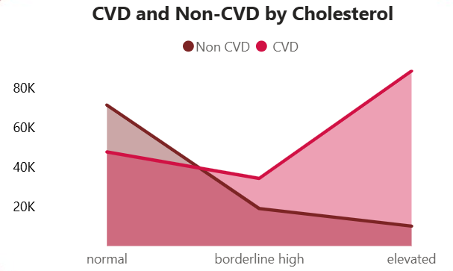
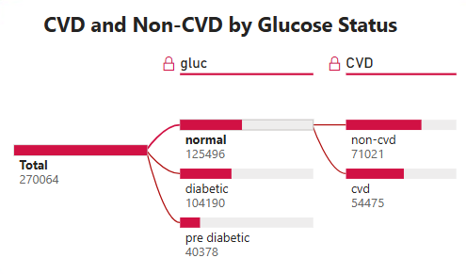
Data Visualization
The chart shows the relationship between cholesterol levels and the number of CVD and non-CVD cases
This chart illustrates the distribution of individuals by Glucose Status and their corresponding CVD vs. Non-CVD outcomes.
CVD cases decrease at the borderline level and rise again at the elevated level, while non-CVD cases gradually decrease as cholesterol levels increase
Starting from the total population, it breaks down into three groups—normal, diabetic, and pre-diabetic—and shows how each group further splits into those with cardiovascular disease (CVD) and those without

Slide 19
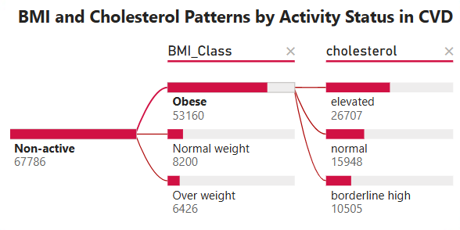
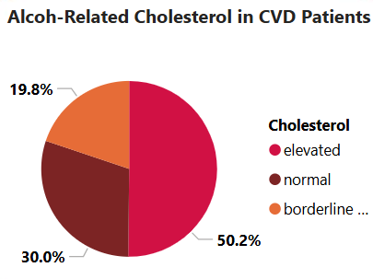
Data Visualization
This chart illustrates the BMI and cholesterol patterns among non-active CVD patients.
This pie chart presents the distribution of cholesterol levels among CVD patients who consume alcohol
The visual highlights that most inactive patients fall into higher BMI classes, which are strongly linked to elevated cholesterol levels. Overall, the chart emphasizes the relationship between inactivity, increased BMI, and higher cholesterol risk in CVD patients.
The chart shows that elevated cholesterol represents the largest proportion at 50.2%, followed by normal cholesterol at 30.0%, while 19.8% of patients fall into the borderline cholesterol category

Slide 20
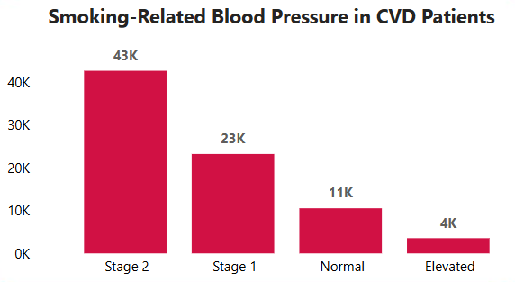
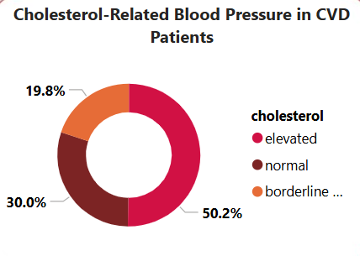
Data Visualization
This chart illustrates the distribution of blood pressure levels among smoking CVD patients
This chart shows the distribution of cholesterol levels among CVD patients
Stage 2 represents the largest group, followed by Stage 1, while normal and elevated blood pressure categories appear at lower proportions
The visual highlights that elevated cholesterol represents the largest proportion, followed by normal and borderline levels.
The chart emphasizes the strong presence of high cholesterol within this patient group.

Slide 22
Assessing Your Cardiovascular Health: An Interactive Tool
This interactive tool empowers you to understand your potential risk of developing cardiovascular disease (CVD). By inputting your health profile, you receive a personalized, instant assessment, enabling you to make informed decisions about your well-being.
How It Works: Your Personalized Health Profile
Our system allows you to select key health attributes through intuitive filters. These selections dynamically update a comprehensive risk assessment, providing a clear picture of your cardiovascular standing.
Age Distribution
Blood Pressure Class
Cholesterol Level
Categorize your age range to refine the risk calculation
Input your blood pressure status ( Normal, Elevated , Hypertension Stage 1 & Stage 2)
Select your cholesterol profile ( Normal ,Elevated, Borderline High)
Smoking Status
Alcohol Consumption
Physical Activity
Indicate whether you are a smoker, or non-smoker
Detail your typical alcohol intake levels
Describe your regular exercise habits and activity levels

Slide 23




Assessing Your Cardiovascular Health: An Interactive Tool
Risk Gauge Indicator
A quick visual interpretation of your calculated CVD risk, presented on a clear scale from 0 to 1. This intuitive gauge instantly categorizes your risk as low, moderate, or high, offering immediate clarity.
Total Matched Records
This metric reveals how many individuals in our extensive dataset share similar health characteristics with you. It provides context, showing how common your unique health profile is within the broader population.
Expected CVD Risk Percentage
Your cardiovascular risk is presented as a precise percentage, offering a clear and intuitive understanding of your individual risk level. This numerical value enhances comprehension and allows for easy tracking over time.
Guidance Message
Receive personalized, dynamic recommendations tailored to your calculated risk. Messages range from encouraging "Low risk – maintain your healthy habits" to urgent "High risk – medical attention or lifestyle changes highly recommended," providing actionable next steps.

Slide 24
Thank You.

Slide 25
Our Project Team
Mohanned Reda Mansour Elsayed
Yasmine Osama Abd Elmak soud Kodwa
Ahmed Abdelaziz Abdelhamid Kroush
Sarah Hosny Mahmoud Qabel
Bassant Khaled Mohamed Salmoon
Amina Mohamed Mohamed Elkholy

